Slide 1
Racial and Gender Bias in AI
Junhong Wang

Slide 2
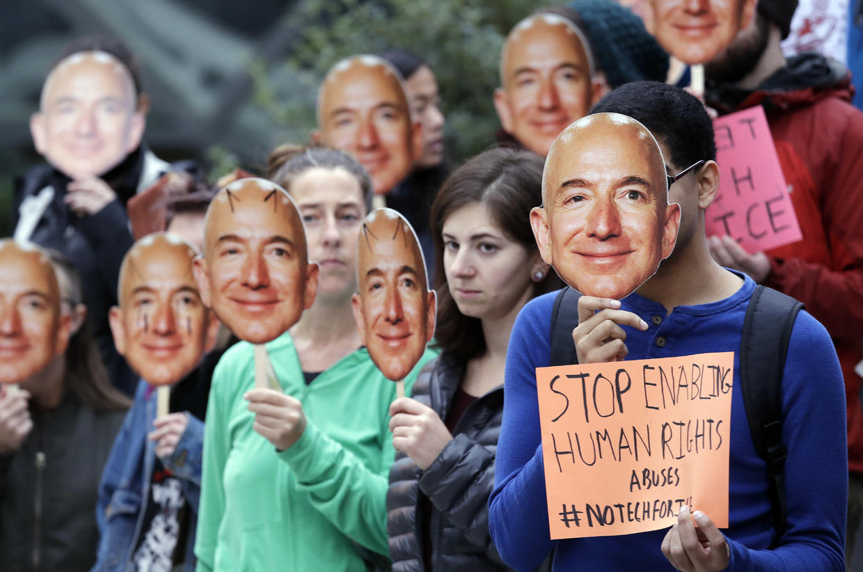
Protesters hold images of Amazon CEO at Amazon Headquarter
and complain its facial recognition system (Oct. 31, 2018, in Seattle.)

Slide 3
Subject | Error Rate (misclassified as opposite sex)
Darker-skinned women
Lighter-skinned women
Darker-skinned men
lighter-skinned men
AI can learn biased from human creators. What potential risks can this cause?
31%
7%
Biased AI can be a threat to civil liberties. Biased AI can be abused to promote gender and racial discrimination.
1%
0%

Slide 4
Roadmap
How does machine learning work?
How does facial recognition work?
What does “AI is biased” mean?
How to fix biased AI?

Slide 5
Roadmap
How does machine learning work?
How does facial recognition work?
What does “AI is biased” mean?
How to fix biased AI?

Slide 6
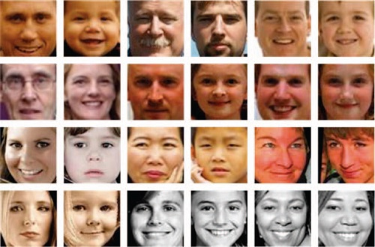
How does machine learning work?
Machine Learning
Model
positive point for female feature.
negative point for male feature.
Big mouth : -1
Bear : -1
Beautiful skin : +1
Large eyes : +1
...etc
Collect the data we want the machine to learn. Each picture should be labeled as “male” or “female”.
The machine tries to figure out the pattern of the faces and the label. (e.g. many females have larger eyes, many males have bears)

Slide 7
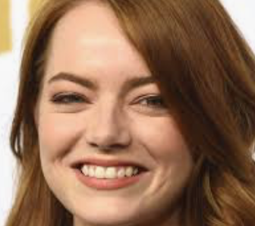
How does machine learning work?
Model
Female!
Big mouth : -1
Bear : -1
Beautiful skin : +1
Large eyes : +1
Hmm… okay, you have a big mouth (-1),
you have a beautiful skin (+1),
you don’t have a bear (+1).
Total point is +1, which is greater than 0.
You are a female!

Slide 8
Roadmap
How does machine learning work?
How does facial recognition work?
What does “AI is biased” mean?
How to fix biased AI?

Slide 9
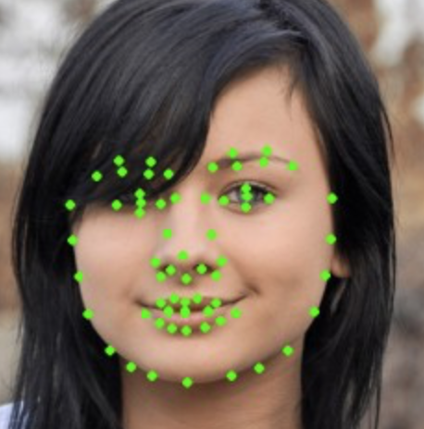
How does facial recognition work?
X coord of nose
Y coord of nose
:
:
Y coord of mouth
For a computer, image is just a collection of pixels. It doesn’t know what an eye, nose or mouth are. We will convert the image to a vector, where each component represent a feature of the face.
A better machine learning algorithm such as neural network can further transform the features of coordinates into more abstract feature (e.g. size of nose, shape of face, etc.)

Slide 10
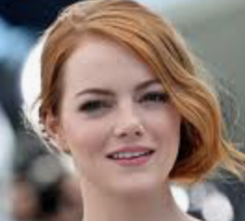
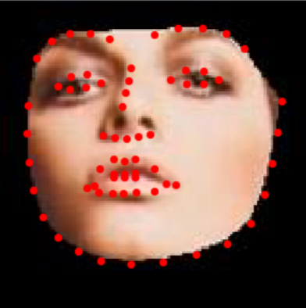
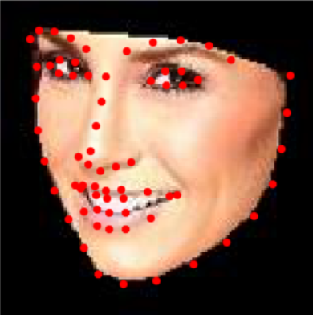
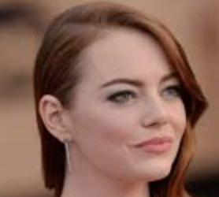

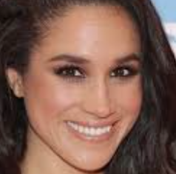
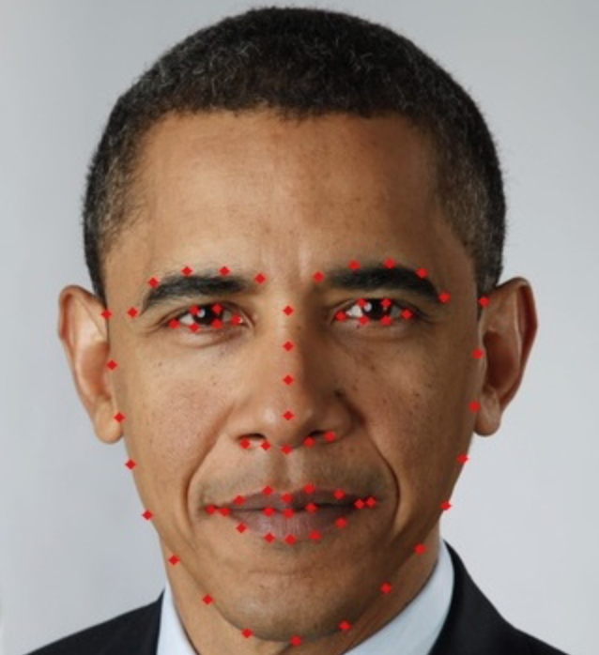
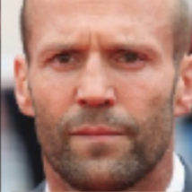


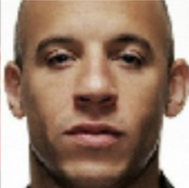

How does facial recognition work?
beauty
The goal of facial recognition is to find the best line that separates the dataset.
We assume that the decision boundary can be expressed as linear combinations of the features.
w1*(Nose size)+w2*(beauty)+100=0
Nose size

Slide 11


How does facial recognition work?
beauty
Faces in blue region are classified as males
Faces in red region are classified as females
Big nose

Slide 12
Roadmap
How does machine learning work?
How does facial recognition work?
What does “AI is biased” mean?
How to fix biased AI?

Slide 13
Roadmap
How does machine learning work?
The math behind the magic
What does “AI is biased” mean?
How to fix biased AI?
It is okay to completely ignore this part. The point of this section is to briefly show you how computer can figure out the best fitting line.

Slide 14
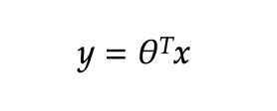
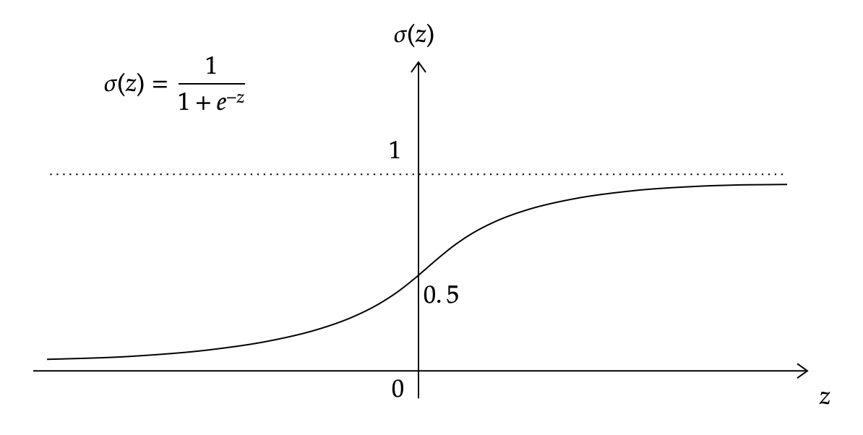
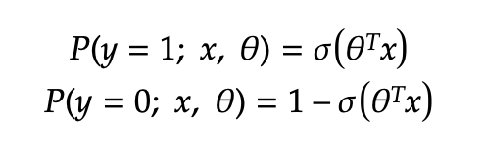
The math behind the magic
Okay, first I’m gonna label male as 0 and female as 1.
Given a face x, y should be 0 if it’s male, otherwise 1.
This is not good because y is either 0 or 1. But theta transpose x can be any value.
We assume y can be represented by linear combination of the features x
Is there a nice function that maps from any real value to a value between 0 and 1? => Sigmoid
Probability to be female
Probability to be male

Slide 15
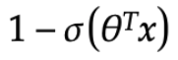
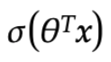
The math behind the magic
Likelihood to be male
Likelihood to be female
We have lots of dataset. We want to maximize the likelihood to observe what we observe.
1-0.3
0.8
1-0.2
0.7
Likelihood = 0.7*0.8*0.8*0.7
We want to find the value of theta to get the maximum likelihood. This type of problem is called optimization problem.
1-0.8
0.2
1-0.9
0.4
Likelihood = 0.2*0.1*0.2*0.4

Slide 16
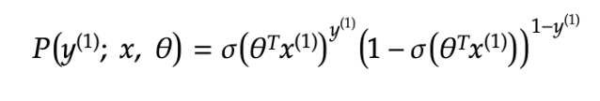
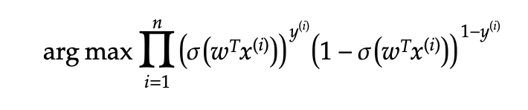
The math behind the magic
y=1
y=0
1-0.3
0.8

Slide 17
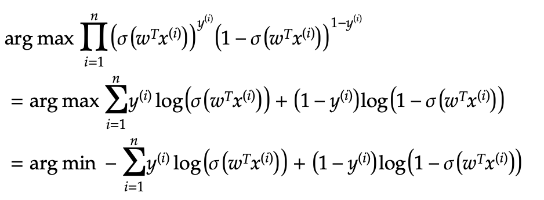
The math behind the magic

Slide 18
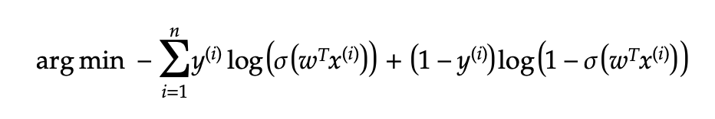
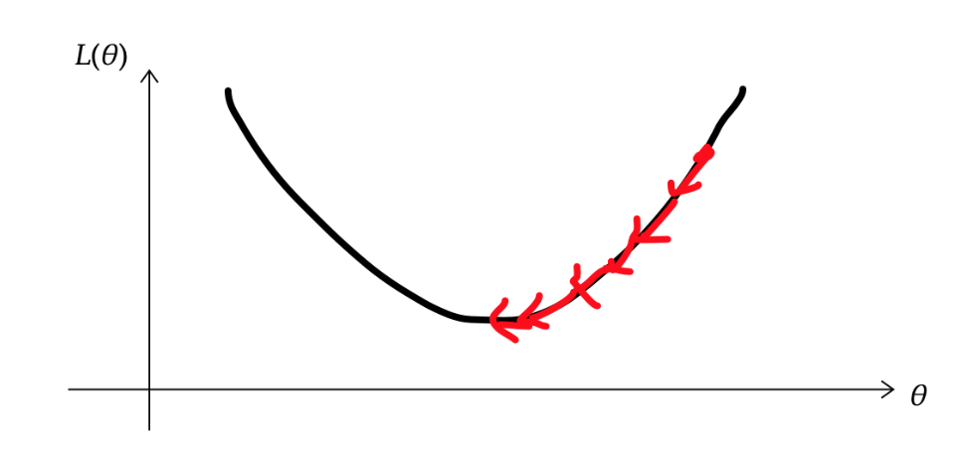
The math behind the magic
We want to move theta to opposite direction of the gradient!

Slide 19
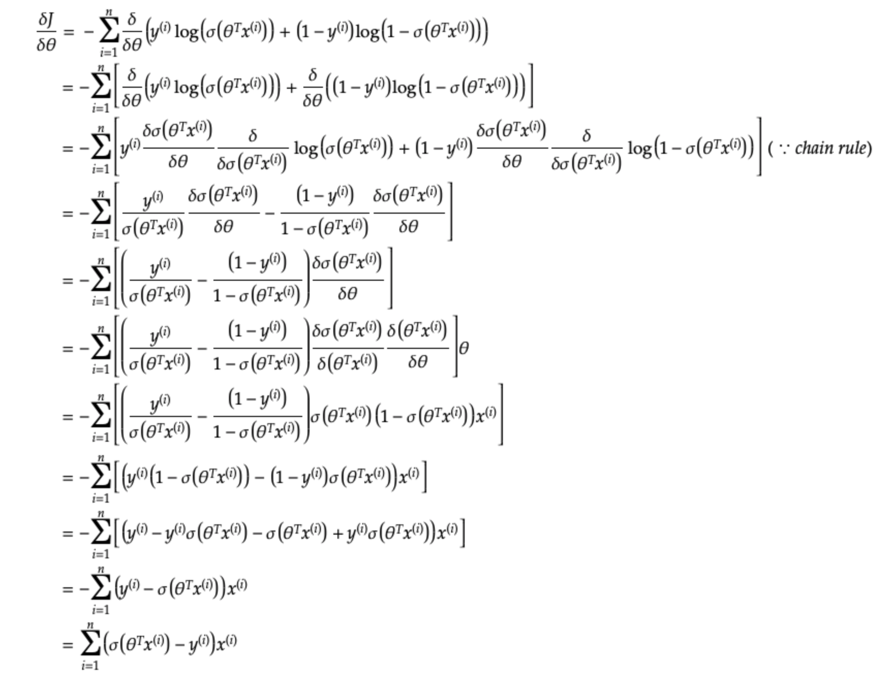
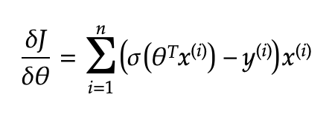
The math behind the magic

Slide 20
Randomly set w
Loop (a lot of times):
Compute the gradient
w = w - 0.01 * gradient
// you found the best w!

Slide 21
Roadmap
How does machine learning work?
How does facial recognition work?
What does “AI is biased” mean?
How to fix biased AI?

Slide 22
What does “AI is biased” mean?
beauty
Nose size

Slide 23
What does “AI is biased” mean?
beauty
This is no longer the best decision boundary!
Nose size

Slide 24
What does “AI is biased” mean?
beauty
New decision boundary
Faces that were recognized as males will now be classified as females because it’s on the left side of the decision boundary!
Nose size

Slide 25
What does “AI is biased” mean?
beauty
Nose size

Slide 26
Roadmap
How does machine learning work?
How does facial recognition work?
What does “AI is biased” mean?
How to fix biased AI?

Slide 27
How to fix biased AI?
Make sure different classes are identically distributed. (e.g. there are 8 female faces and 2 male faces right now. This is not good!)
beauty
Nose size

Slide 28
References
“Amazon Face-Detection Technology Shows Gender and Racial Bias, Researchers Say.” CBS News, CBS Interactive, 26 Jan. 2019, www.cbsnews.com/news/amazon-face-detection-technology-shows-gender-racial-bias-researchers-say/.
Daumé, Hal. “A Course in Machine Learning.” A Course in Machine Learning, http://ciml.info/dl/v0_9/ciml-v0_9-ch06.pdf.
Namee, Mac B et al.“The problem of bias in training data in regression problems in medical decision support.” www.scss.tcd.ie/publications/tech-reports/reports.00/TCD-CS-2000-58.pdf.

